Slide 1
“JOB SEARCH WEBSITE”
Task - 1

Slide 2

JOB SEARCH WEBSITE
Your Project Introduction
LMS Username | Name | Batch
2113a52189 | MUGILAN.E | A52
2113a52167 | ADITH NARAYAN.A | A52
2113a52168 | AJMAL MOHAMMED.S | A52
2113a52183 | MANOJ J | A52

Slide 3
Task - 1
Creation of SRS & Github
Create SRS : “JOB SEARCH WEBSITE”
Creation & Set-up of Github account
Creation & Hands-on to various commands of Git Bash
Evaluation Metric:
100% Completion of the above tasks
Learning Outcome
Get to know about different lifecycle models.
Understanding importance and how to create an SRS
Knowing various commands of Github
Understanding agile and scrum management techniques for efficient product development

Slide 4
SRS for “JOB SEARCH WEBSITE "
Functional Requirements
User Login Registering
New User Searching for Jobs
Uploading Resumes
Admin Managing Employers
Users Managing
Jobs Managing Details

Slide 5
SRS for “JOB SEARCH WEBSITE "
Non Functional Requirements
Usability
Performance
Scalability
Availability
Reliability
Compatibility
Security

Slide 6
SRS for “JOB SEARCH WEBSITE "
Software Requirements
Programming Language - JAVA
Web Server Apache
Database - MYSQL
Content Management System –WordPress
Search Engine
CDN
App Development Framework

Slide 7
SRS for “JOB SEARCH WEBSITE "
Hardware Requirements
i3 Processor Based Computer
1 GB RAM
50 GB Hard Disk
Monitor
Internet Connection

Slide 8
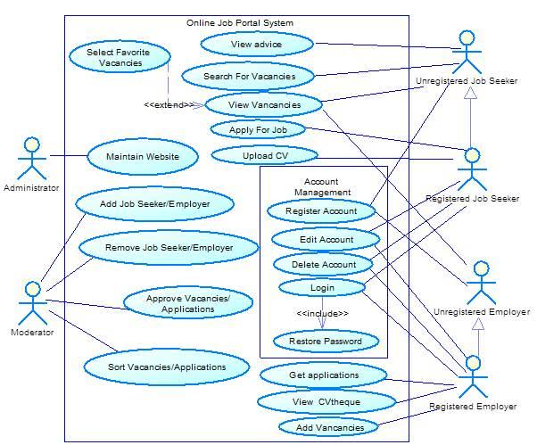
USE CASE DIAGRAM

Slide 9
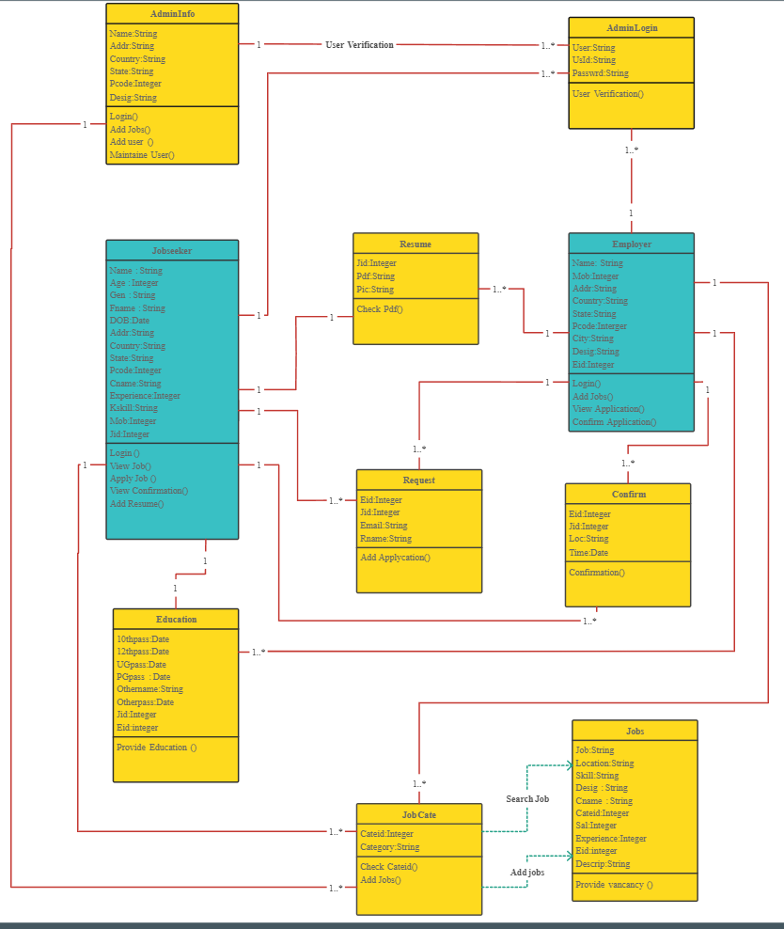
CLASS DIAGRAM

Slide 10
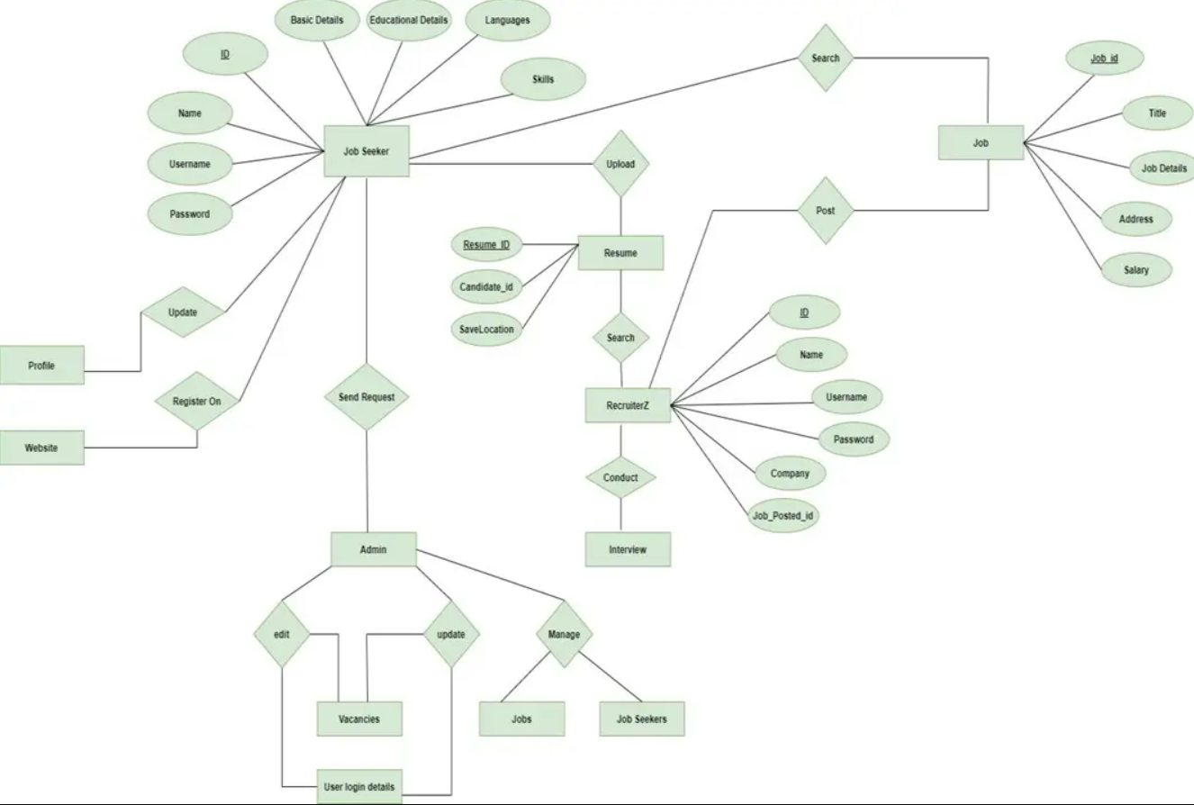
ER DIAGRAM

Slide 11
Step-Wise Description
Initial Requirements Collection
Start of DB structure
Start of Front End Development
End of DB structure
Completion of Front End
Start of Back End
Complete entire app
Test of App
Deployment
Summary of your task
Each task is scheduled among the members of the team according to their interest

Slide 12
Assessment Parameter
Gather requirements for the project
add Readme.md file with description of the project
Prepare database design schemas
Check-List
Commit all changes with "first commit"
Get your initial project Structure ready
create a repository on github realted to project
Initiate a git repository
Push your changes to github

Slide 13
Submission Github
https://github.com/manoj2608/Naan-Mudhalvan_FSD-Batch_A52_6/tree/main/Task%201

